Slide 1

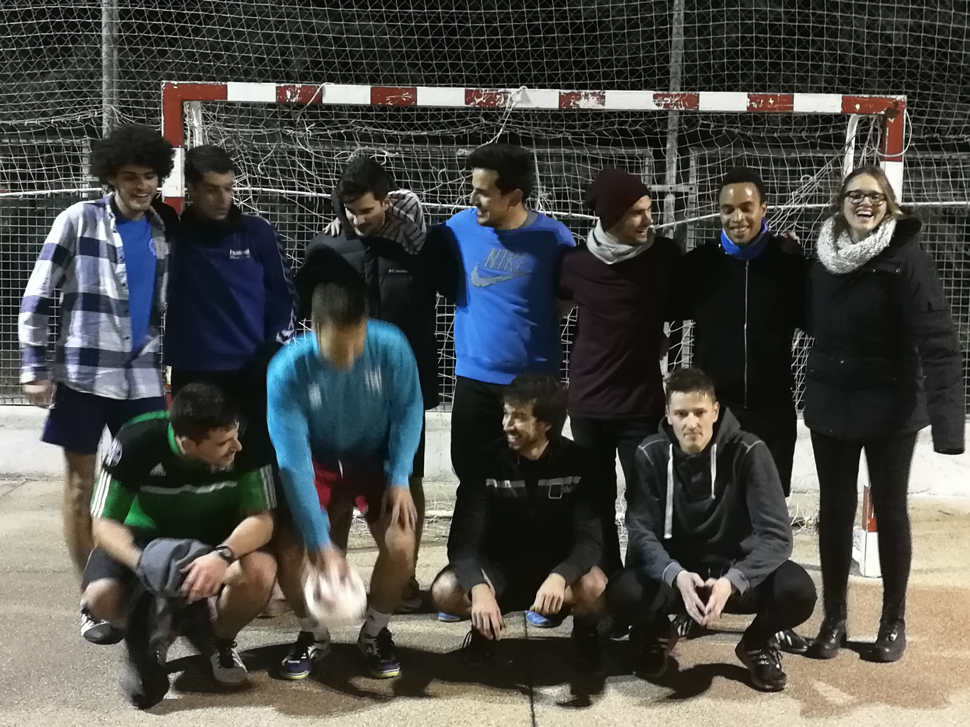
The MSTC Team

Slide 2
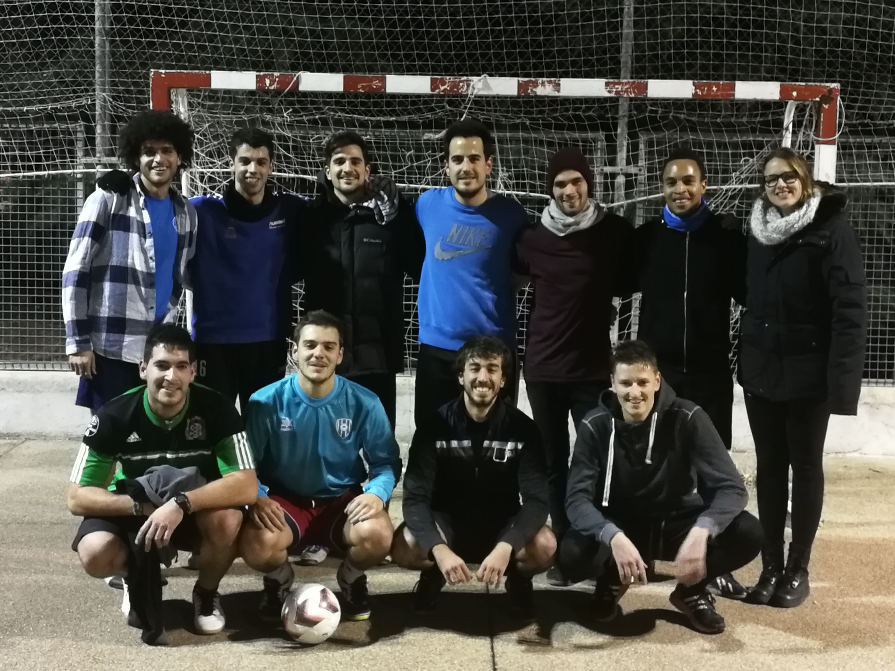

Slide 3

https://github.com/MasterMSTC/RvsPython/

